Slide 1
WELCOME TO YEAR 1
2026-2027

Slide 2

TEACHERS
1G | 1B
Gemma Raw Imogen Stephens | Blaire Gove
LSAs: Debbie Smith | LSAs: Shaz Bakhtiyar Clarice Greenhalgh

Slide 3
GENERAL INFORMATION ABOUT YEAR 1
Year 1 can feel like a big step up from Reception, as learning becomes a little more structured and children take part in more group activities. However, we still have continuous provision throughout the day, giving children plenty of opportunities to learn through play and explore areas such as construction, role play, creative activities and small world. Our provision is regularly enhanced to link to the children’s learning, allowing them to practise skills independently and develop their imagination, problem-solving and social skills.
We are also continuing to develop our outdoor area, which the children can access in the afternoons for active and creative learning. Throughout the year, there will be lots of exciting experiences and events, including Christmas celebrations, school trips and Sports Day. In June, all children will take part in the national Phonics Screening Check, with an information meeting for parents held closer to the time.

Slide 4
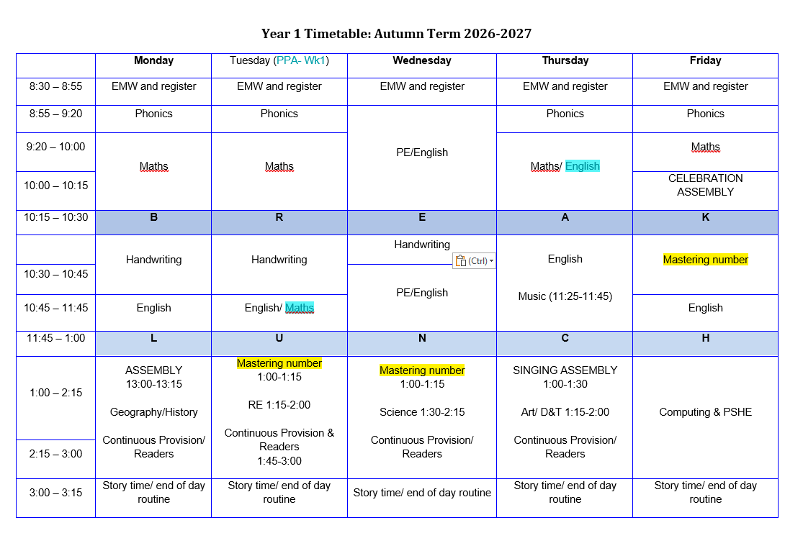
Timetable
Children participate in daily whole-class inputs for all subjects.
In English, they complete a weekly teacher-led small-group writing activity alongside continuous provision like role play, fine motor skills, playdough, and drama.
In Maths, whole-class inputs are followed by small-group tasks in PowerMaths books with teacher and LSA support.
Afternoon sessions feature whole-class lessons in various subjects, followed by activities that encourage consolidation and group work skills.

Slide 5

- The children will take their Year 1 Phonics Screening in June.
- The screening consists of 20 ‘real’ and 20 ‘alien’ words. The children have to read these words however they do not need to tell us if they are real or not. The ‘alien’ words will have an alien next to them.
- The alien words are there to make sure the children are using their sounds to decode words instead of sight reading.
- We will be teaching phonics every day.
- If the children do not pass, they will retake the screening in Year 2.
- A great way to practice for the screening is by using Phonics Play:
https://www.phonicsplay.co.uk
- More information regarding the phonics screening will be given in the Spring and Summer curriculum meetings.

Slide 6
How to say the sounds:
https://cdn.oxfordowl.co.uk/2016/05/05/20/22/32/561/20097_content/index.html?id=ae
Digraph – a sound made up of two letters e.g. au (haunted) or ai (rain).
Trigraph – a sound made up of three letters e.g. ear (spear) or air (chair).
Split digraph – a sound made up of two letters, split in the middle e.g. u_e (flute) or o_e (bone).

Slide 7

READING
- All children will have a set reading day; this is when they will read their given book with their teacher or LSA
- The children need to bring their reading books into school with them everyday as we might also get a chance to do some extra reading with them on a different day.
- We encourage you to read your child’s banded reading book with them at least 4 times a week.
-Children are also encouraged to borrow a book from our class library for you to read to them. We have a wide variety of fiction and non-fiction books for them to choose from and this will expose them to a wider vocabulary and develop their reading for pleasure.

Slide 8
ENGLISH
- We focus on a different text either weekly or fortnightly. The children will complete different activities such as role play, ‘hot seating’, story ordering and a written piece of writing in different formats such as a letter, story or character description.
- The main focuses for the Autumn term will be continuing to encourage the children to use their phonics so that they can sound out words more independently, full stops, capital letters, finger spaces and letter formation. We will also be encouraging the children to think about adjectives.

Slide 9
MATHS
- The scheme used for maths is called ‘Power Maths.’
The children will each have their own workbook which they will complete a set of pages of each week.
The topics for the Autumn term are:
Numbers 1 – 10 (sorting, one more/one less, ordering, first, second, third).
Part-whole within 10 (number bonds).
Addition and subtraction within 10.
2D and 3D shapes (naming and patterns).
Numbers to 20 (counting, one more/one less, ordering, comparing).

Slide 10

HOMEWORK
- Homework is given out every Thursday and is due back in on the following Tuesday.
- The homework usually consists of an activity relating to our learning for the week. The activities will alternate between English and Maths and handwriting.
https://docs.google.com/document/d/1w2FMGL3M1VrZsw4LxvlCfUolrQ6sfBiP/edit

Slide 11

HOW CAN YOU HELP AT HOME?
Phonics: Children will be bringing home sound mats, which are the same ones we use in school. These can be used to support their writing at home. Please encourage your child to listen carefully for the sounds they can hear in words and write these down, rather than giving them the correct spelling straight away.
Reading (Phonics Focus): When reading, encourage your child to spot digraphs and trigraphs (two or three letters making one sound). For example, in the word brain, guide them to first recognise the ai sound before blending the word.
Reading (Comprehension): Alongside sounding out, encourage blending and ask lots of questions about the book. Talking together about the story and characters will help develop your child’s comprehension skills.
Handwriting: We follow the Oxford Owl Nelson Handwriting scheme. Each week, we will let you know which letters the children have been learning. Please encourage your child to practise forming these letters correctly at home.

Slide 12
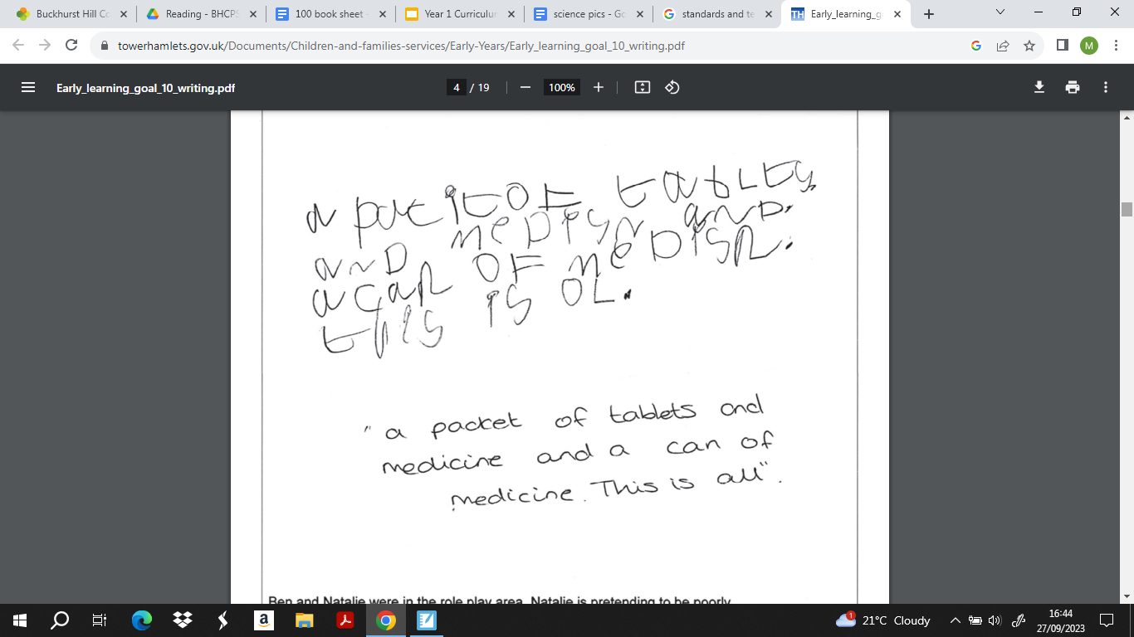


Slide 13
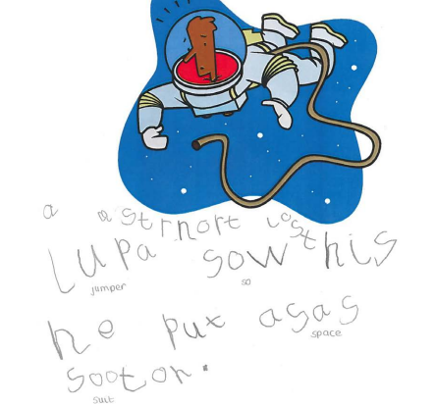

Slide 14

PE
- PE will be taught on Wednesdays
- The children will need to arrive in school in their PE kit.
- The kit should include navy blue shorts and t-shirt or a navy-blue jumper and jogging bottoms for the winter.
- Shoes can include black plimsolls or white, navy or black trainers.
- No earrings should be worn on these days.

Slide 15
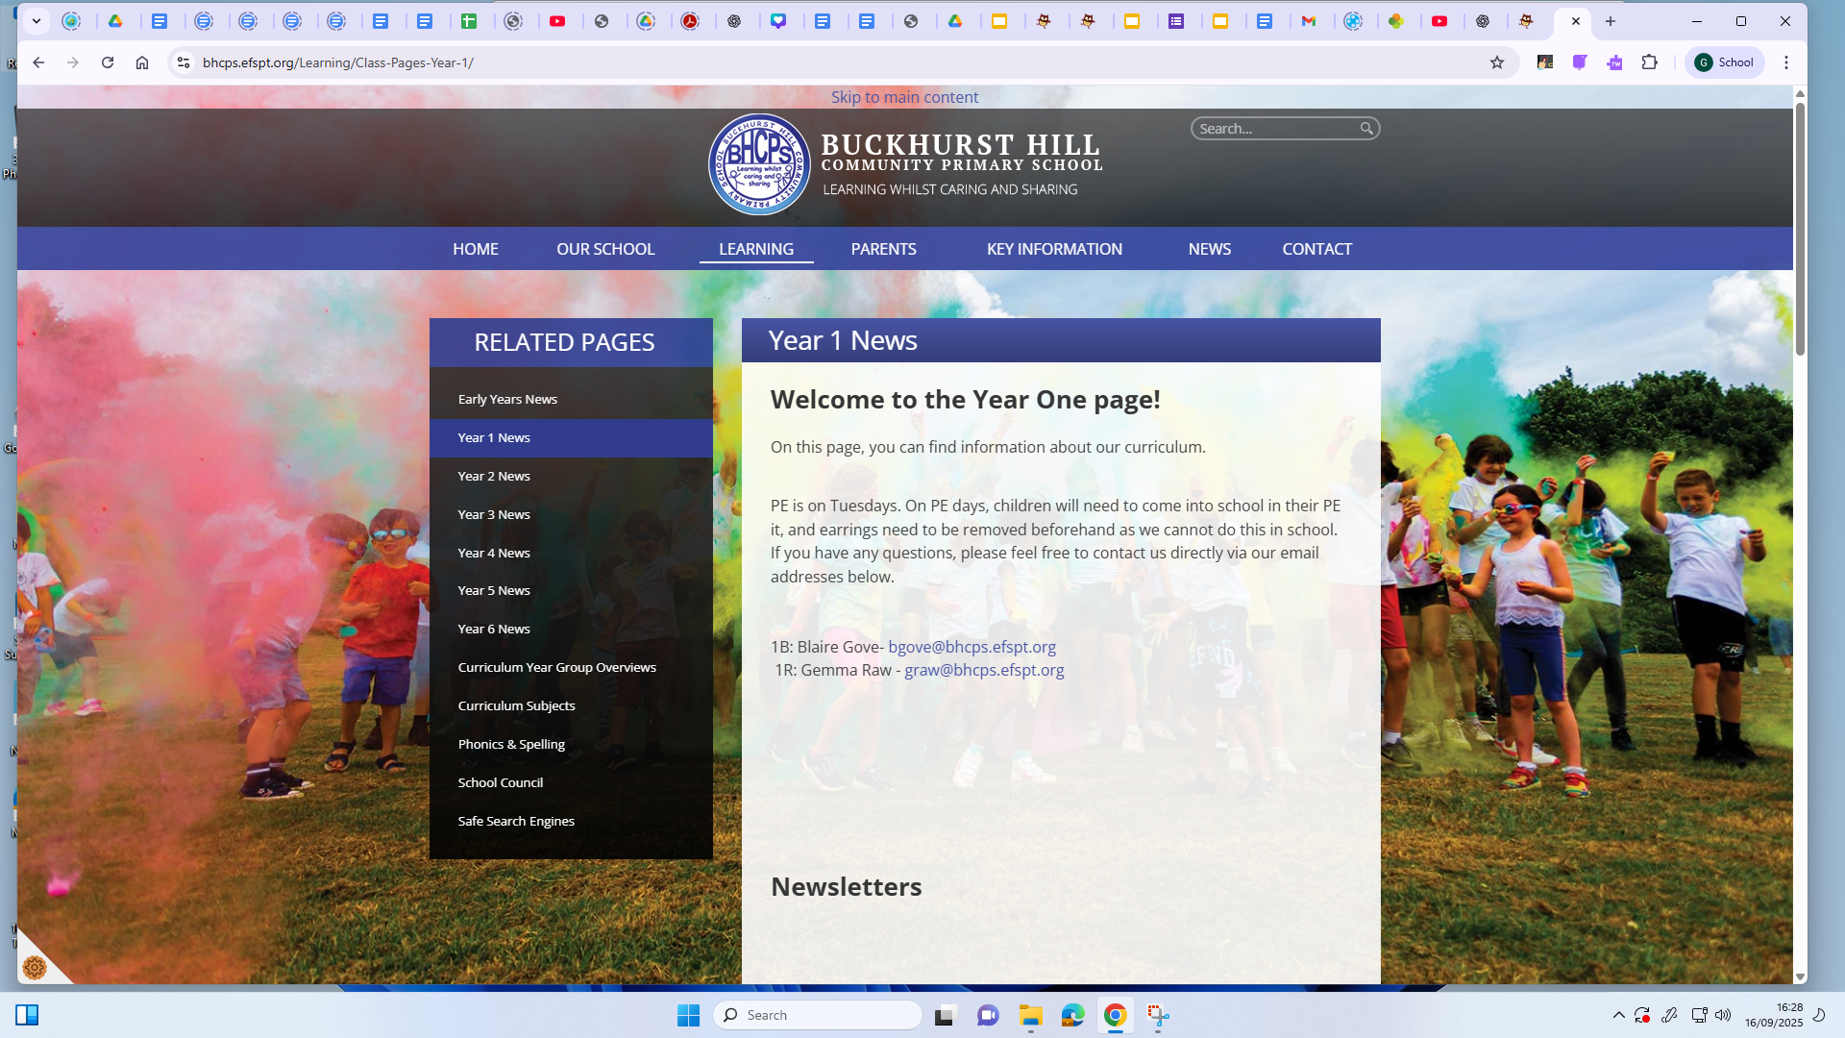
CURRICULUM
- You can find our Year 1 curriculum information on the school website.
- The website also features a Year 1 class page where we will include other helpful links for you to use at home – be sure to check it out. https://www.bhcps.efspt.org/Learning/Class-Pages-Year-1/

Slide 16

ANY QUESTIONS?
We are on the door every morning and afternoon and are always happy to answer any questions! Please don’t hesitate to get in touch using the email addresses below:
Gemma Raw: graw@bhcps.efspt.org
Blaire Gove: bgove@bhcps.efspt.org

